Slide 1
UCSD Embedded Linux Assignment 5
By
Hsuankai Chang
hsuankac@umich.edu

Slide 2
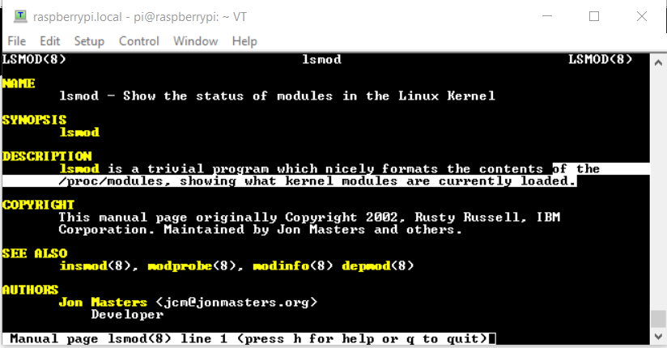
Step 1. man lsmod

Slide 3
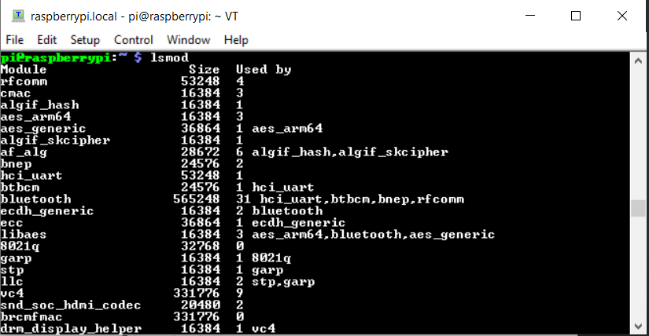
Step 2. lsmod demo

Slide 4
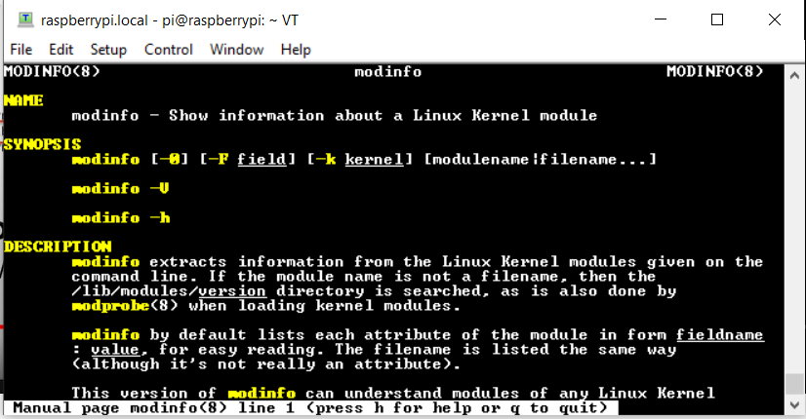
Step 3. man modinfo

Slide 5
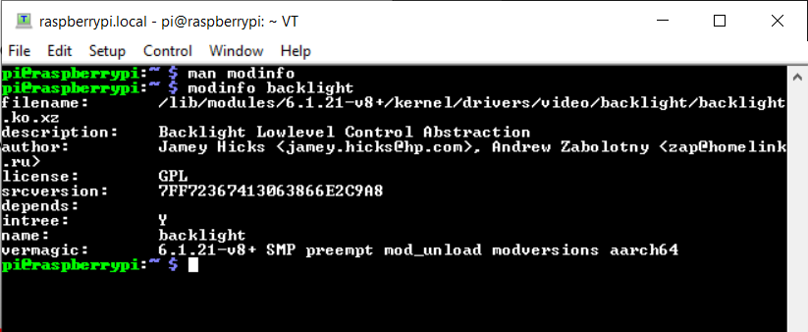
Step 4. Demo: modinfo backlight

Slide 6
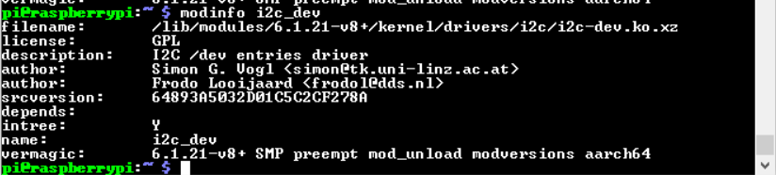
Step 5. Demo: modinfo i2c_dev

Slide 7
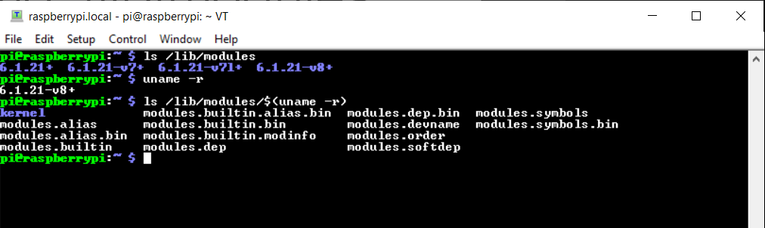
Step 6. Demo: /lib/modules

Slide 8
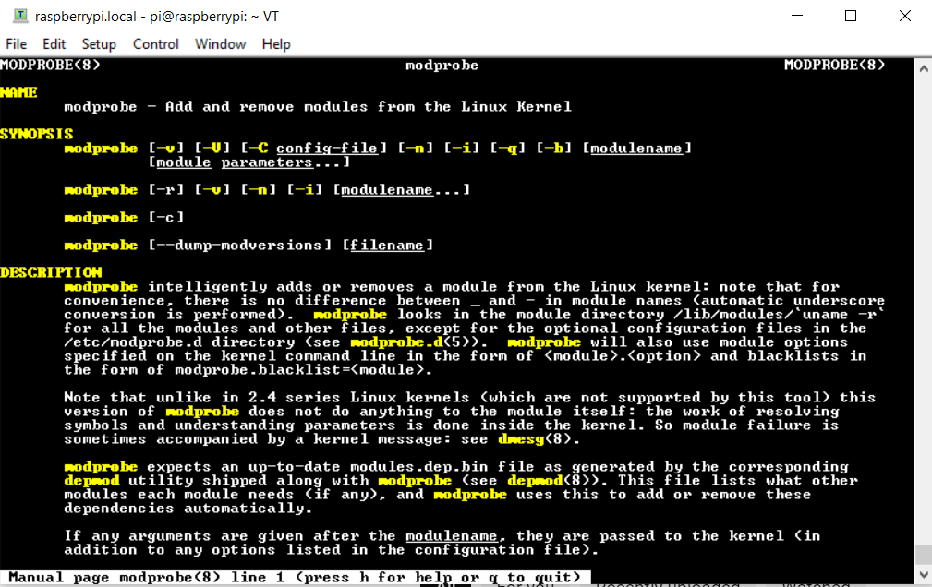
Step 7. man modprobe

Slide 9
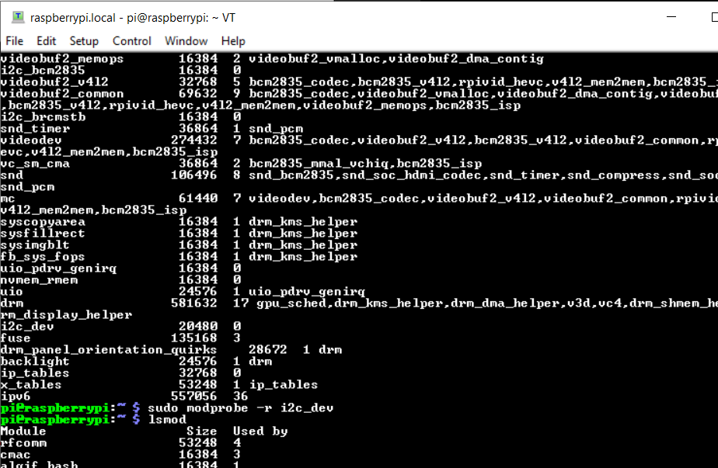
Step 8. Demo: modprobe –r, I played around with the i2c_dev module

Slide 10
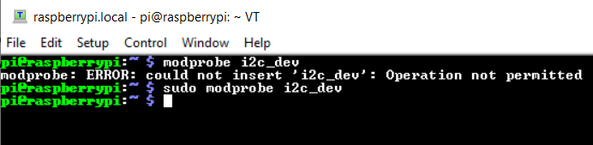
Step 9. Demo: Adding the module back

Slide 11
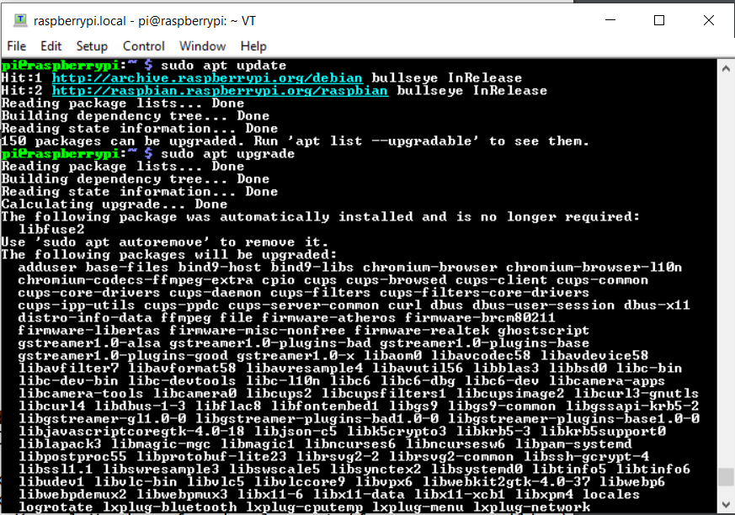
Step 10. Installing Kernel Headers Step 1

Slide 12
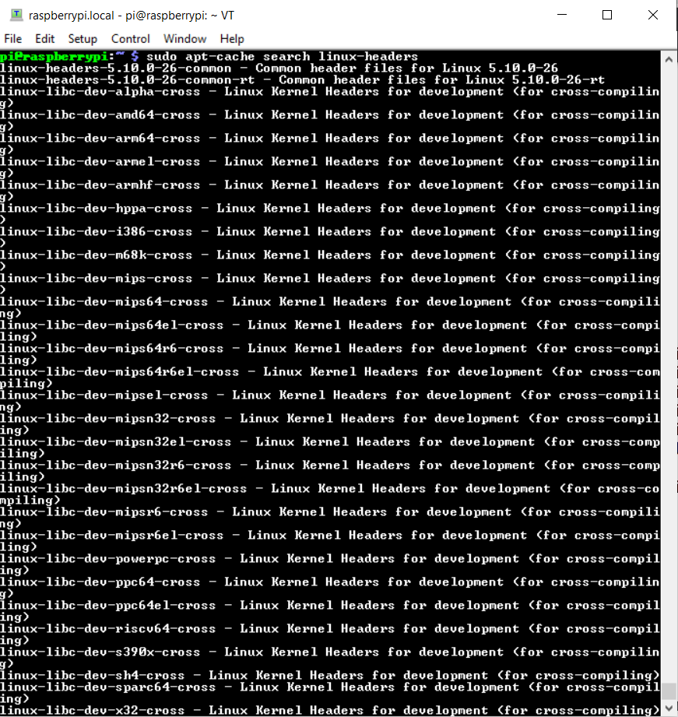
Step 11. Installing Kernel Headers Step 2

Slide 13
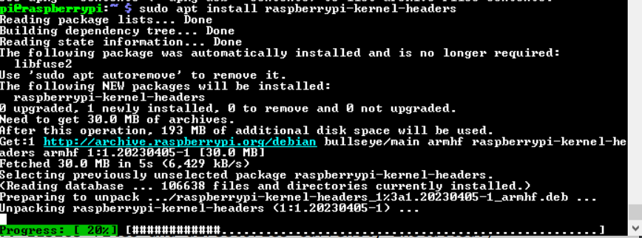
Step 12. Installing Kernel Headers Step 3

Slide 14
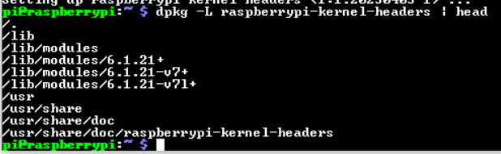
Step 13. Installing Kernel Headers Step 4

Slide 15
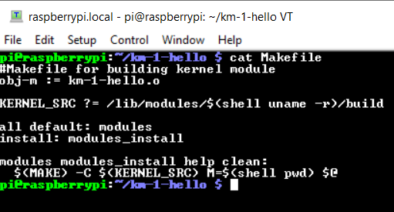
Step 14. Makefile

Slide 16
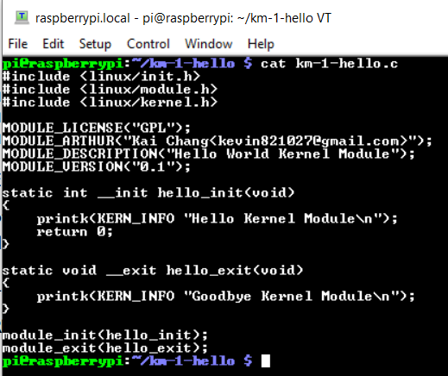
Step 15. km-1-hello.c

Slide 17

Step 16. make error

Slide 18
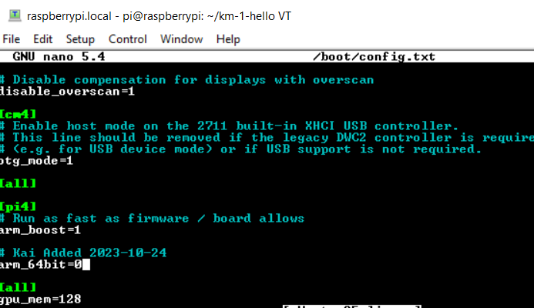
Step 17. Modify the /boot/config.txt file

Slide 19
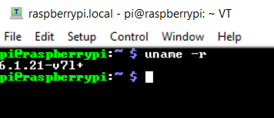
Step 18. After rebooting, version becomes v71+

Slide 20
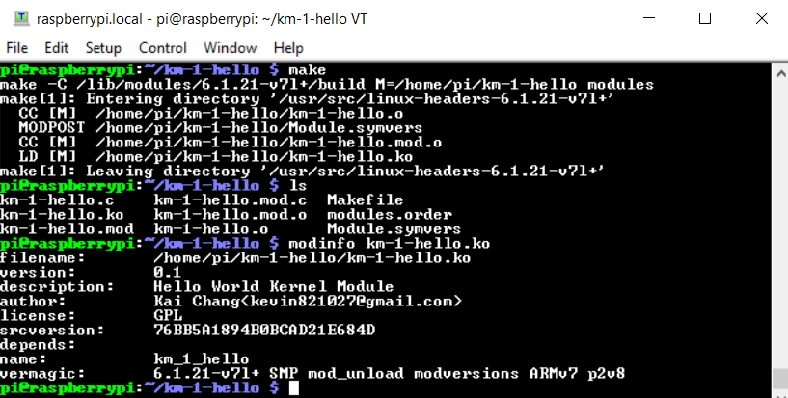
Step 19. After changing to v71+, the build is successful

Slide 21
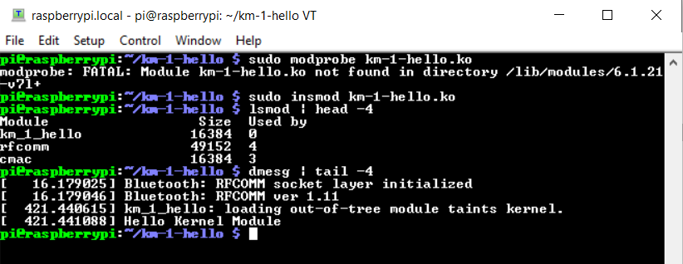
Step 20. Loading Kernel Module

Slide 22
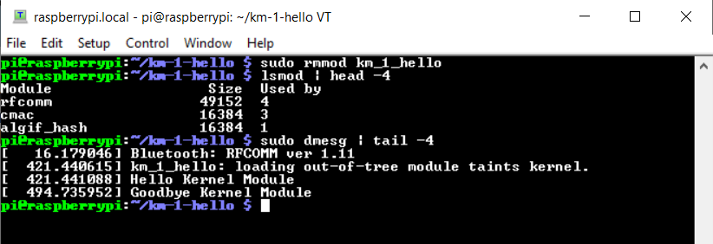
Step 21. Unloading Kernel Module

Slide 23
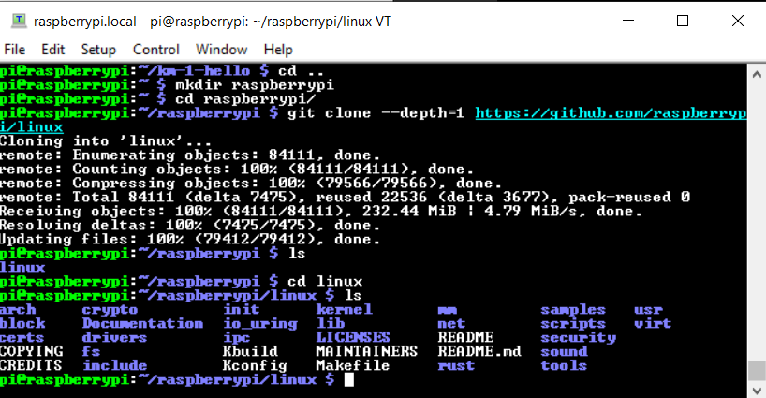
Step 22. Download Rpi source

Slide 24
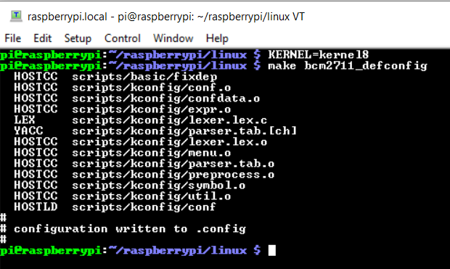
Step 23. Default Kernel Configuration

Slide 25
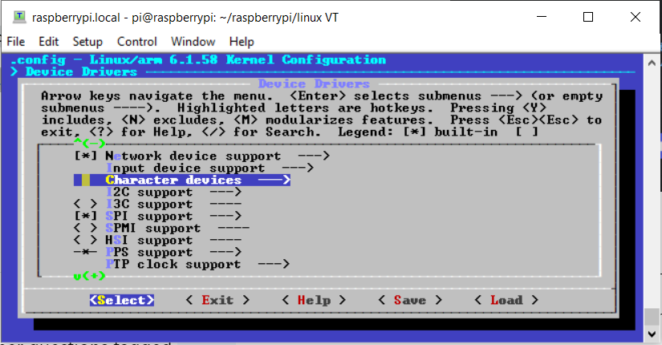
Step 24. make menuconfig

Slide 26
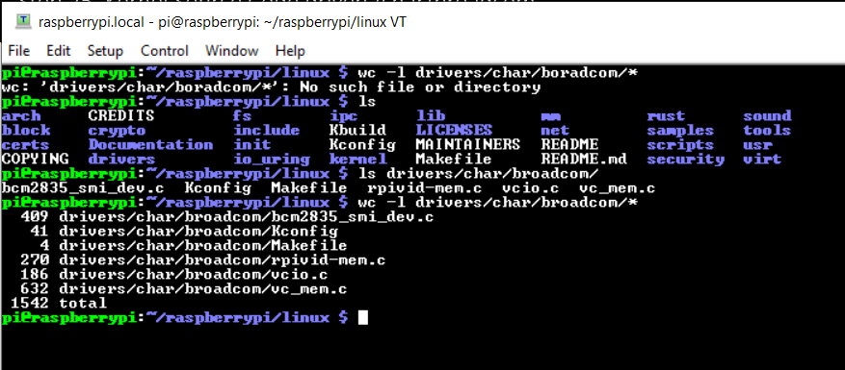
Step 25. Kernel Source Code drivers/char/broadcom

Slide 27
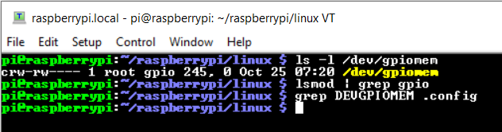
Step 26. ls /dev/gpiomem. Question: Why my last command did not show anything

